Slide 1

SMART MEDICINE REMINDER AND VENDING MACHINE
THIRD INDIVIUAL MEETING: CODE INTEGRATION
INSTRUCTOR: Prof. Mike Aleshams
Student Name: Nishitha Kodur
Student ID: C0771813

Slide 2
Table of Contents
Introduction
Block Diagram
Code to Launch HTML page
Explanation of Threading
HTML code
HTML Page
Code to activate stepper driver and motors
Code for SpeakOut function
Code for interfacing Arduino uno to Raspberry pi
Code for LCD display
Code for sending email attachment
Code for PIR interfacing
Code for Camera module interfacing
Final code Integration
Parallel processing codes integration
References

Slide 3
Introduction
To overcome the problem of forgetting to take medicines in elderly people, we came up with a 'SMART MEDICINE REMINDER AND VENDING MACHINE.
' It is an IoT device which reminds and dispenses medicine on time.
In this project , we design and develop a medicine reminder and vending machine using Amazon Alexa and Raspberry pi.
The machine saves dispense and alarm time, when it is time to dispense the medicine, the machine alarms and dispenses the medicine boxes to the user.

Slide 4
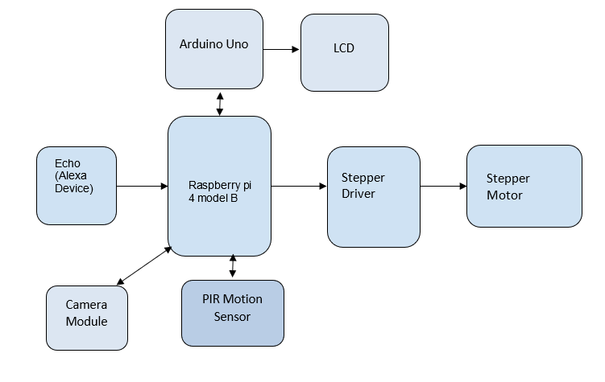
Block Diagram

Slide 5
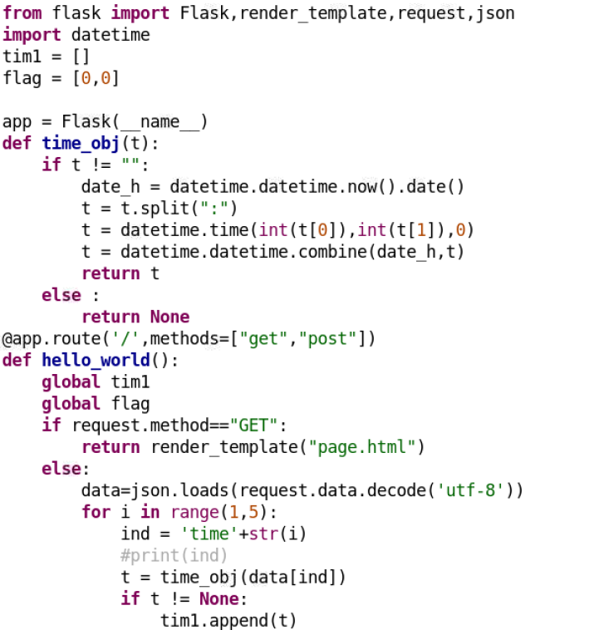
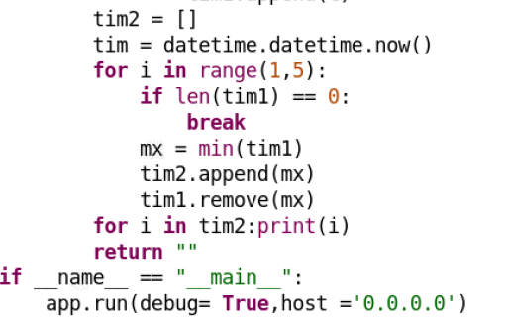
Code to launch HTML page
Below python code is to launch HTML page, from this HTML page user will be able to input 4 different times for the medicine box to dispense.

Slide 6
Code to launch HTML page
Explanation of the code:
from flask import Flask, render_template,request,json: Importing flask, render_template, request and json from Flask library.
Render_template: To render HTML page.
Request: To handle the URLs.
Json: We are creating a server to launch a HTML page. Here in the HTML page user inputs time into the page. We are creating json format to fetch the time inputs given by the user.
Import datetime: To acquire current date and time of the system.

Slide 7
Code to launch HTML page
tim1[]: It is an array (called list in python). This stores the 4 time inputs (Time 1, Time 2, Time 3, Time 4)
app = Flask(__name__): Creating server object called flask app. And next we are creating functions.
def time_obj(t): Creating time function. From HTML page we get response in text format. This function converts text information to time object.
if t=!“” (i.e. if time is not empty response from HTML page then next lines in the function are executed.
time object contains both date and time. date_h= to create date object using datetime module.
Date is taken as current date as per the system. Just user has to mention time for the medicine to dispense.

Slide 8
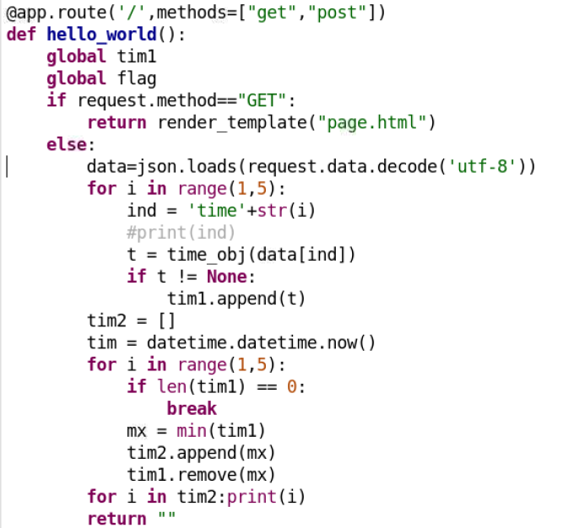
Code to launch HTML page
datetime.time(int(t[0]), int(t[1]),0)= Here int(t[0]) is hours, int(t[1]) is minutes and 0 is seconds by default.
This function is to create HTTP request. HTTP request basically contains two methods Get and Post.
When a user requests with the IP address of raspberry pi with 8080 port, hello_world() function is executed.
If request is Get, then we have to render HTML page.
Post Request: After user enters information in the HTML page and hits submit, Post Request URL will be created.
Using decode(‘utf-8’) format we are decoding text to string
format.
for loop – for i in range(1,5) is to sort the time if given randomly by the user.

Slide 9

Code to launch HTML page
Here we use the IP address of raspberry pi with port as 8080 to connect to this html page.
i.e. 192.168.2.35:8080

Slide 10
Explanation of Threading
Here, we are using threading method which helps us run two different codes at the same time. Here the previous code to launch the HTML page and this code to calculate time run simultaneously using threading.
Python threading allows us to have different parts of the program run concurrently and can simplify our design.
A thread is a separate flow of execution. This means that our program will have two things happening at once.

Slide 11
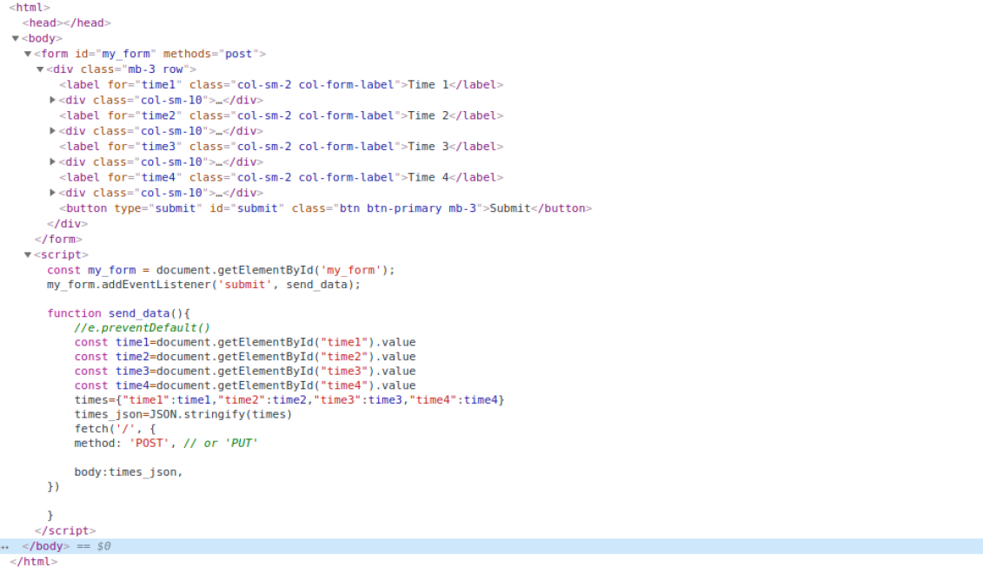
HTML Code

Slide 12
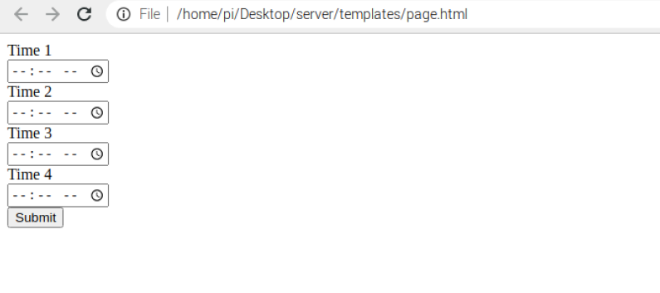
HTML Page
HTML page consisting to give time inputs from user end.

Slide 13
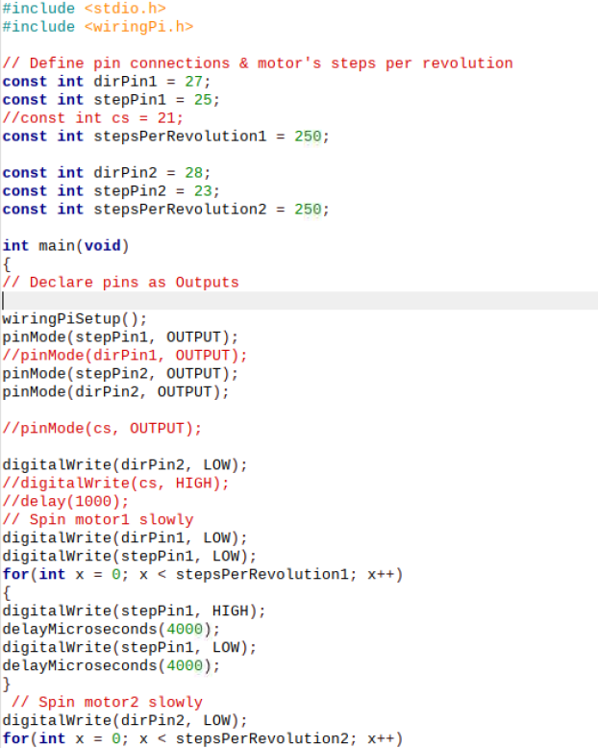
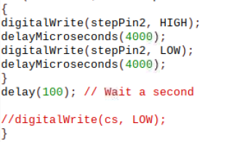
Code to activate Stepper driver and motors
Below is the C code to activate stepper driver and motors for dispensing of medicine boxes according to the time inputs given in HTML page.

Slide 14
Code to activate Stepper driver and motors
Explanation of the code:
// Define pin connections & motor's steps per revolution
const int dirPin1 = 27; //DIR pin of 1st stepper driver to WiringPi 27
const int stepPin1 = 25; //STEP pin of 1st stepper driver to WiringPi25
const int stepsPerRevolution1 = 250; //Defining steps per revolution of 1st stepper driver
const int dirPin2 = 28; //DIR pin of 2nd stepper driver to WiringPi 28
const int stepPin2 = 23; //STEP pin of 2nd stepper driver to WiringPi 23
const int stepsPerRevolution2 = 250; //Defining steps per revolution of 2nd stepper driver

Slide 15
Code to activate Stepper driver and motors
pinMode(stepPin1, OUTPUT); //Defining STEP pin of 1st driver pin as output
pinMode(dirPin1, OUTPUT); //Defining DIR pin of 1st driver pin as output
pinMode(stepPin2, OUTPUT); //Defining STEP pin of 2nd driver pin as output
pinMode(dirPin2, OUTPUT); //Defining DIR pin of 2nd driver pin as output
digitalWrite(dirPin2, LOW); //Defining DIR pin of 2nd driver as LOW
// Spin motor1 slowly
digitalWrite(dirPin1, LOW); //Defining DIR pin of 1st driver as LOW
// Spin motor1 slowly
digitalWrite(dirPin1, LOW); //Defining DIR pin of 1st driver as LOW

Slide 16
Code to activate Stepper driver and motors
digitalWrite(stepPin1, LOW); //Defining STEP pin of 1st driver as LOW
for(int x = 0; x < stepsPerRevolution1; x++) //For loop for revolution of 1st stepper motor
for(int x = 0; x < stepsPerRevolution2; x++) //for loop for revolution of 2nd stepper motor

Slide 17
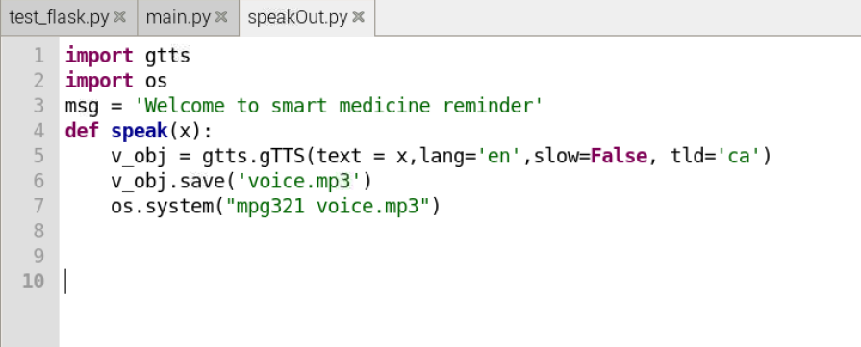
Code for SpeakOut function
The below python code is to convert text to speech using gtts (google text to speech). Alexa speaks out based on the timings set.

Slide 18
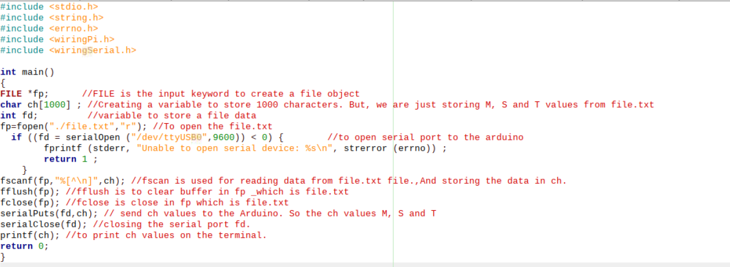
Code for interfacing Arduino uno to Raspberry pi
Below C code is used for interfacing Arduino uno to raspberry pi. This code will in turn run with the LCD display code for displaying values.
This C code reads data from file.txt and sends the data to Arduino for LCD display.

Slide 19
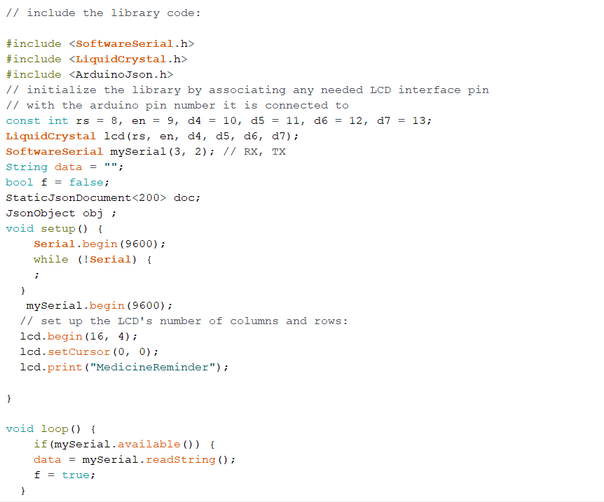
Code for LCD Display
Below is the C code written in Arduino IDE. This code is used for LCD display.

Slide 20
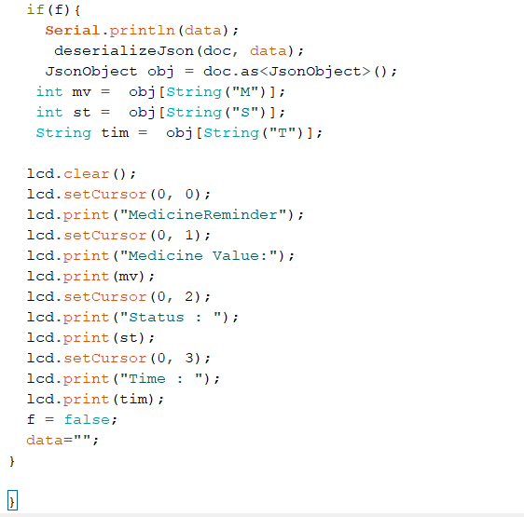
Code for LCD Display

Slide 21
Code for LCD Display
M, S, T which are values of Medicine value, Status and Time. These values are taken from the json file which we saved as file.txt.
File.txt: Time calculations are done in python. To display time in LCD we are using C. file.txt is used to store the time calculated by python and reading the data with C.
Medicine value can be 1,2,3 or 4
Status: 0 or 1. 1 defines running state; i.e. when the time inputs are submitted in the HTML page. Else, Status will be 0
Time: This displays the time of the medicine box dispense.

Slide 22
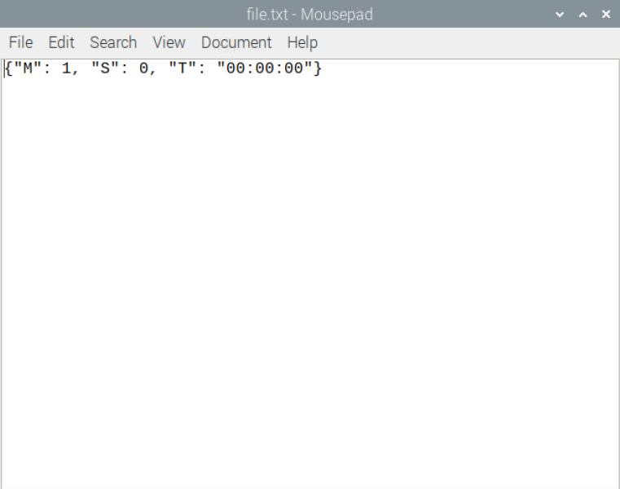
Code for LCD Display
Below is the file.txt where M, S, T values are stored dynamically in json format from HTML page.

Slide 23
Code for LCD Display
Output:
On the LCD display, the below text will be displayed:
MedicineReminder --this is displayed in column 0 row 0
Medicine Value: --this is displayed in column 0 row 1
Status: --this is displayed in column 0 row 2
Time: --this is displayed in column 0 row 3

Slide 24
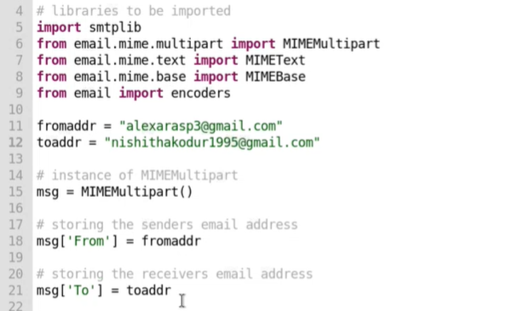
Code for sending email attachment
Below python code is used for sending email to the user/caretaker with an attachment of a recorder video taken of the patient during medicine dispense.

Slide 25
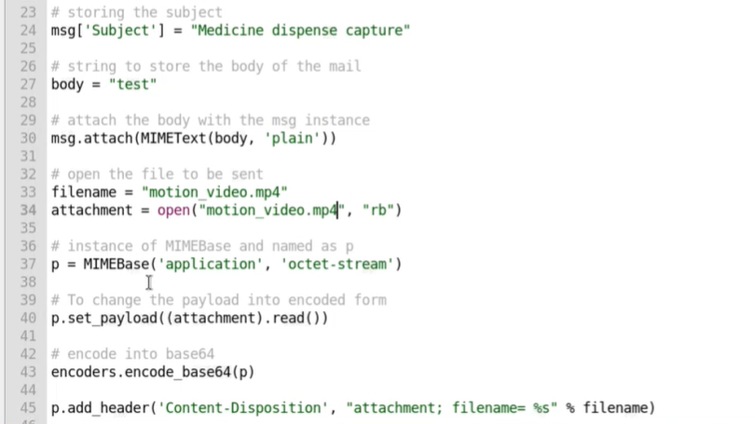
Code for sending email attachment

Slide 26
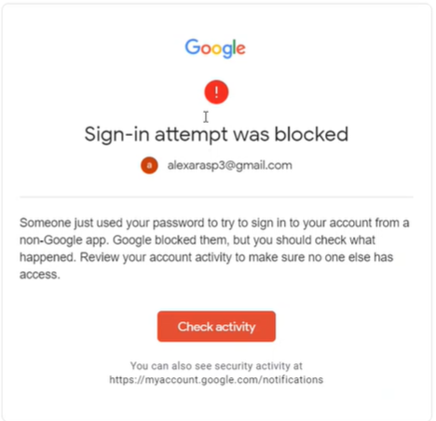
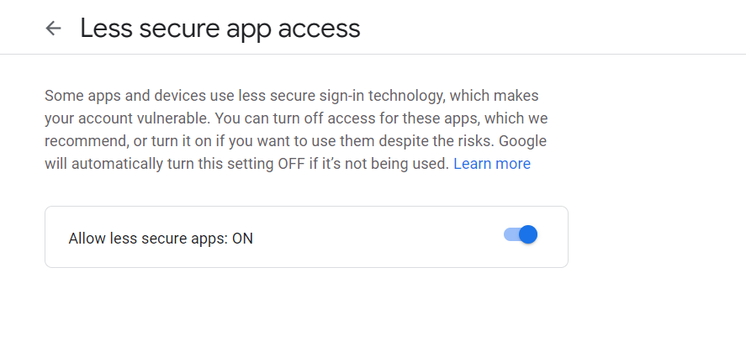
Code for sending email attachment
Make sure to give access to less secured apps from the sender gmail account, else the login will be blocked by gmail account.
Open the below link to turn this on. https://myaccount.google.com/u/1/lesssecureapps?rapt=AEjHL4MXxtyTSD1bqhXOlAwENEdXSlUvxXDSk7j9O-qYVXiqHcvSJ12pOR1lj3jYTYRu1BUvNtWF4IKn4vn0eOq4DP6XzQs5uA&pli=1

Slide 27
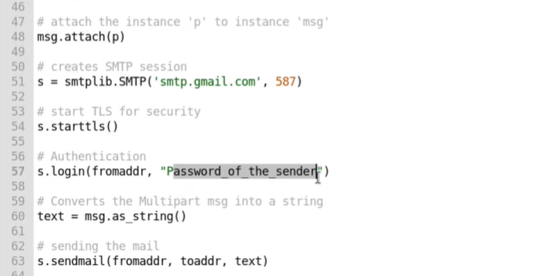

Code for sending email attachment
Also, password of the sender should be provided. So that while execution, system directly logins into the gmail account and sends email to the registered receiver.

Slide 28
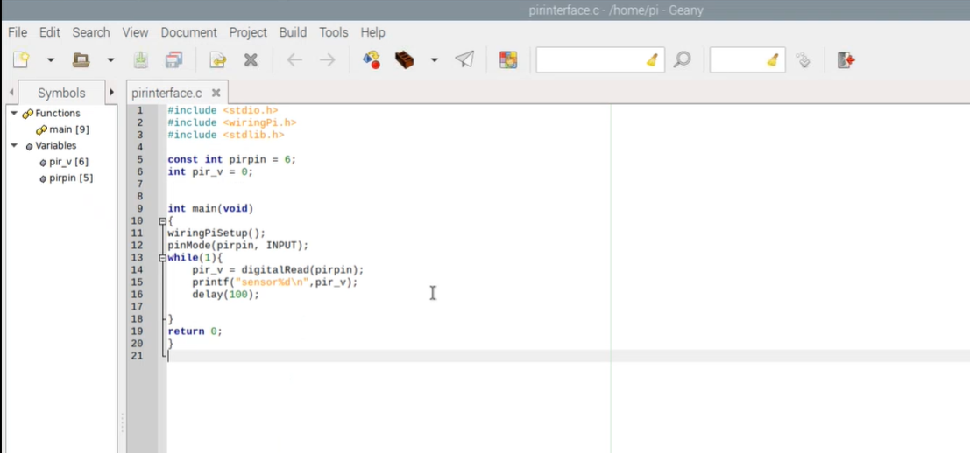
Code for PIR interfacing
Below C code is used for interfacing PIR with raspberry pi for motion detection.

Slide 29
Code for PIR interfacing
Explanation of code:
Stdio.h and stdlib are the standard libraries for various input and output functions in C.
wiringPi.h is the library used to mention the pins used on the raspberry pi. It is an attempt to bring Arduino-wiring like simplicity to the raspberry pi.
int pirpin = 6 here we are using 6th wiring pin of the raspberry pi and initializing it with variable as pirpin.
pinMode(pirpin, INPUT)= declaring pirpin as input pin

Slide 30
Code for PIR interfacing
Then we created a while loop with digitalRead function. This function reads the data on PIR pin.
In printf we are printing that value.
Also, we have specified a delay of 100 milliseconds.
This code runs in loop.

Slide 31
Code for Camera module interfacing
In order to convert the h.264 format video taken to mp4 we add one more line to the code as follows:
#include <stdlib.h> int main(void) { system("raspivid -o motion_video.h264 -t 1000");
system("MP4Box -add motion_video.h264 motion_video.mp4"); //This line of code converts the .h264 to mp4 format
return 0; }

Slide 32
Final code Integration
The final code which is main.py code has the below codes integrated in it
HTML Launch code (Python Code)
Time Calculation code (Python Code)
File_test.c execution (For interfacing with Arduino and displaying information on LCD) (C code)
Stepper code execution (C code)
The final code is written in Python, where this calls all the execution files while the machine is in running state.

Slide 33
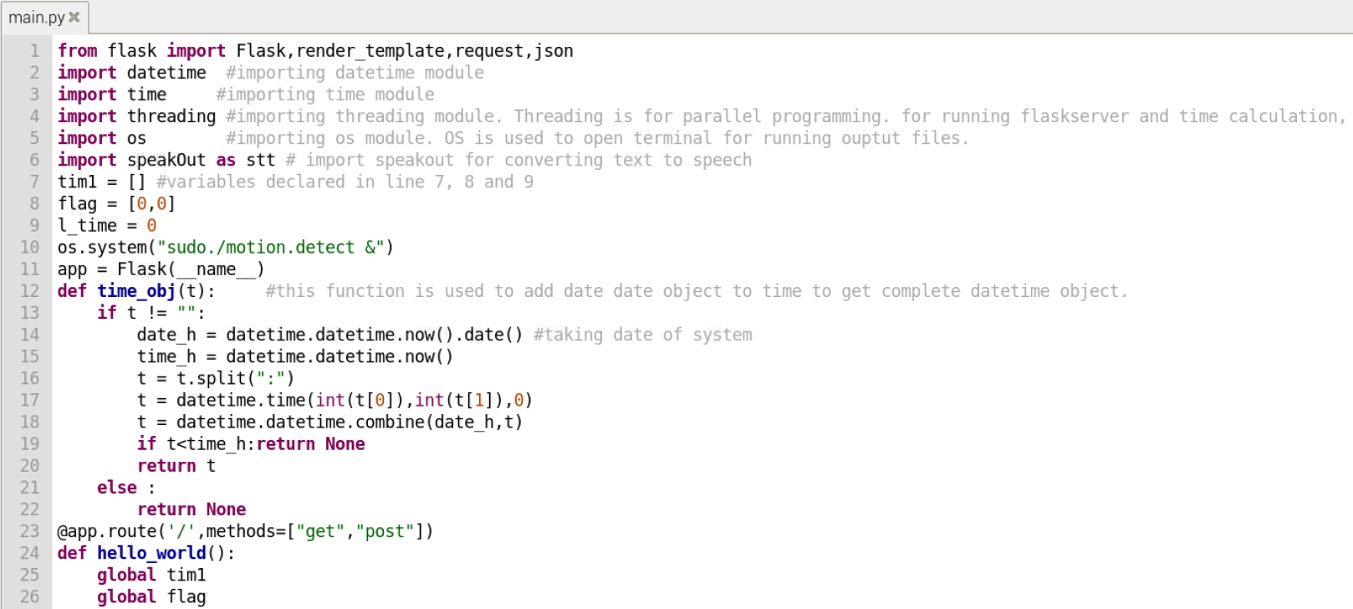
Final code Integration
The final code is saved in main.py file.

Slide 34
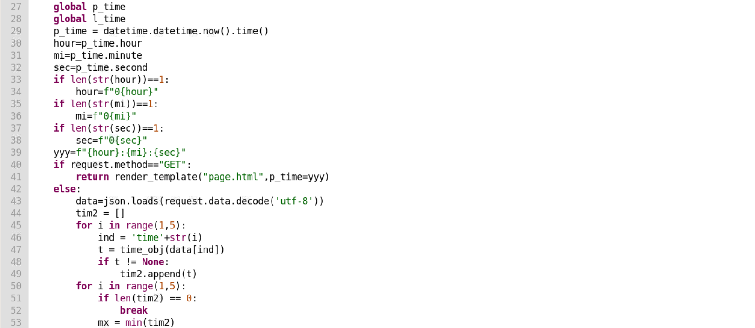
Final code Integration

Slide 35
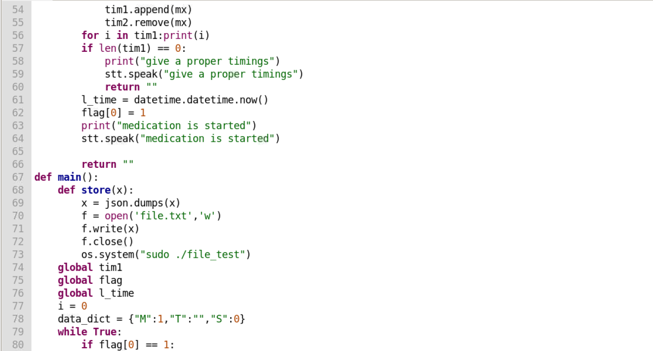
Final code Integration

Slide 36
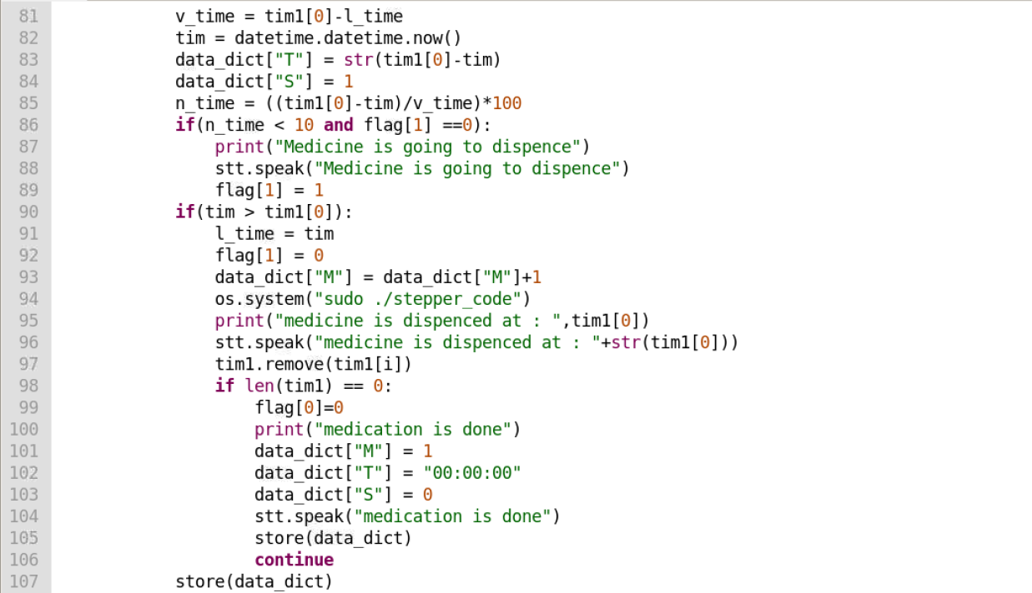
Final code Integration

Slide 37
Final code Integration

Slide 38
Parallel processing codes integration
The parallel processing codes are as below:
PIR sensor (C Code)
Capturing motion video and conversion from .h264 format to mp4 format (C code)
Sending the video as an attachment to the user email address configured (Python Code)

Slide 39
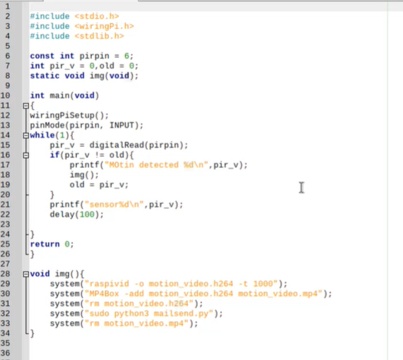
Parallel processing codes integration
Below C code is for interfacing camera module and PIR with raspberry pi.
Motion detection, capturing video, conversion from .h264 to mp4 format and sending email are combined in this code.

Slide 40
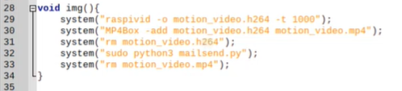
Parallel processing codes integration
mailsend.py python code will be called to send email with an attachment.
Explanation of code: When motion is detected, below void img() function is called and the lines of code are executed.
Here we first record the video in .h264 format in line 29.
Then, we convert it to mp4 format in line 30. After this, we remove the .h264 video as we do not need it after conversion to mp4 in line 31.
In line 32, we are calling mailsend.py code to send this video as an attachment to the registered email address.
Once the video is sent, in line 33 we remove the video.

Slide 41
References
SaiKumar. (2021). python_flask_server_for_time_select.
Retrieved from GitHub: https://github.com/saikumar-mandaji/text_to_speech/blob/main/speakOut.py
SaiKumar. (2021). text_to_speech.
Retrieved from GitHub: https://github.com/saikumar-mandaji/text_to_speech/blob/main/speakOut.py
Amazon. (n.d.). Pair Your Phone or Bluetooth Speaker to Your Echo Device.
Retrieved from Amazon: https://www.amazon.com/gp/help/customer/display.html?nodeId=GG8S76D3BYTGC424
Anderson, J. (n.d.). An Intro to Threading in Python.
Retrieved from RealPython: https://realpython.com/intro-to-python-threading/
Bansal, R. (2017, October 22). Send mail with attachment from your Gmail account using Python.
Retrieved from Geeks for Geeks: https://www.geeksforgeeks.org/send-mail-attachment-gmail-account-using-python/
SaiKumar. (2021). motion_detect.
Retrieved from GitHub: https://github.com/saikumar-mandaji/motion_detecti/blob/main/test_pir.c
Raspberrypi. (n.d.). Build a Python Web Server with Flask.
Retrieved from Projetcs.Raspberrypi: https://projects.raspberrypi.org/en/projects/python-web-server-with-flask

Slide 42
References
SaiKumar. (2021). Motion Detection.
Retrieved from GitHub: https://github.com/saikumar-mandaji/motion_detecti
tutorialspoint. (n.d.). C Library.
Retrieved from Tutorials Point: https://www.tutorialspoint.com/c_standard_library/stdio_h.htm
Pinout.xyz. (n.d.). WiringPi.
Retrieved from RaspberryPi pinout: https://pinout.xyz/pinout/wiringpi

